Slide 1
CAN Features
Agenda
CAN Speed
CAN Data
CAN Bus
CAN Logic
CAN Controllers and Transceivers
CAN Network Topology
Shyam Bhat
Vichara Vandana

Slide 2
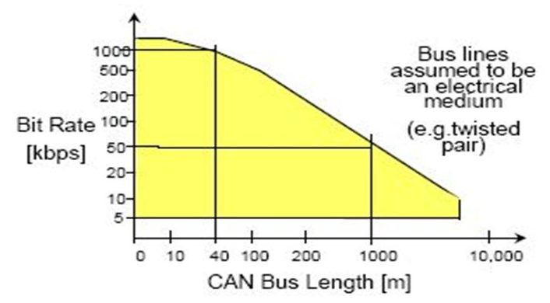
CAN Speed
CAN frames ca go up to 1mbps speed with the bus length at max of 40 mts.
As the bus length increases above the maximum speed reduces.
In industry usually the CAN is configured at 500kbps speed
Lets say the baud rate is 500kbps → In 1 second, 500 *1000 bits can be transmitted
Lets say a single frame takes about 125 bits for example (without stuffing 111 bits)
So in a second the bus can fit around 2000 (500k /125) frames

Slide 3
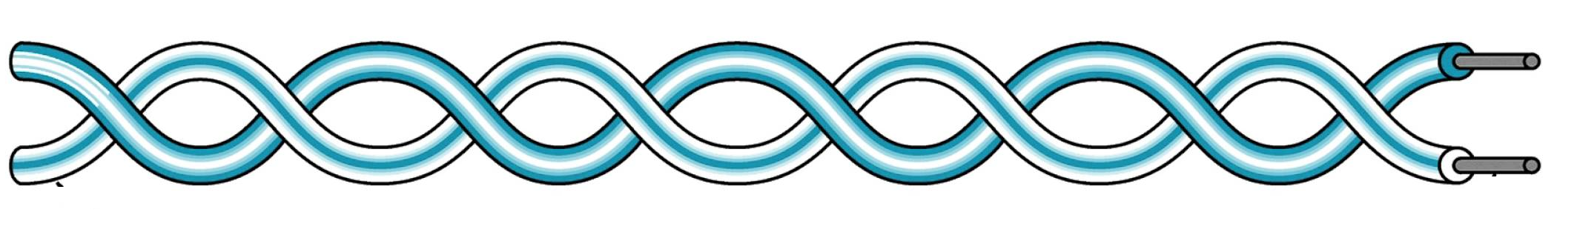
Data Limit
ECU 1
Application 1
ECU 2
Application 2
frame
Data
Frame has 2 parts: PCI and Data
As per CAN protocol How much data can be sent in each frame? → 8 Bytes
Is the data size variable? → Yes we can have 0 bytes or 1 byte or 2 bytes etc. Max is 8 bytes.
Is it possible to have data in bits? → No. Its in bytes. We cant have 2 bit or 27 bits etc its always in bytes.

Slide 4
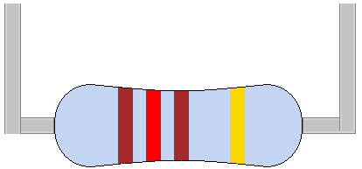
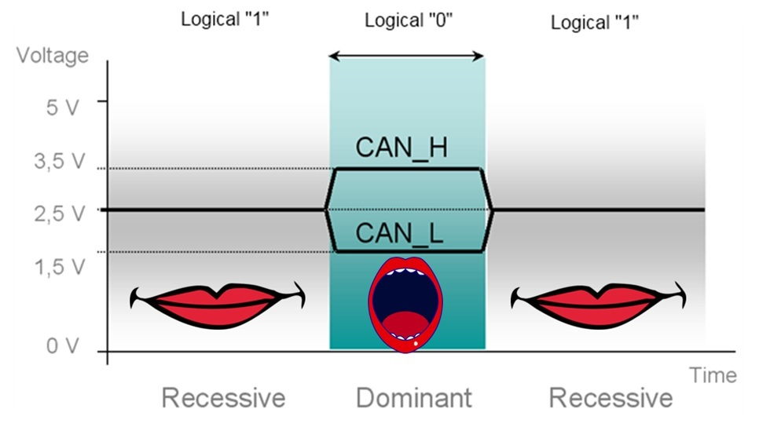
CAN Bus
120 ohm
Can High
Can Low
CAN bus is a Dual-Twisted pair wires called CanHigh and CanLow
Differential Voltage Logic
Logic1 = Recessive bit
Logic0 = Dominant bit
Why twisted pair? → Noise Immunity
Terminated with 120 ohm resistor → Impedance matching
Micro controllers work with TTL and not CAN logic

Slide 5
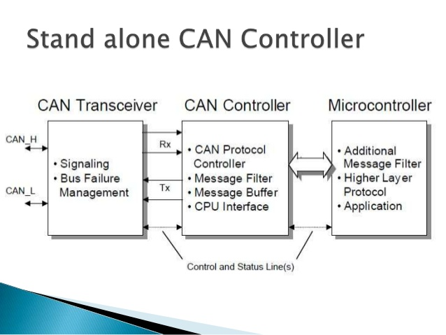

Slide 6
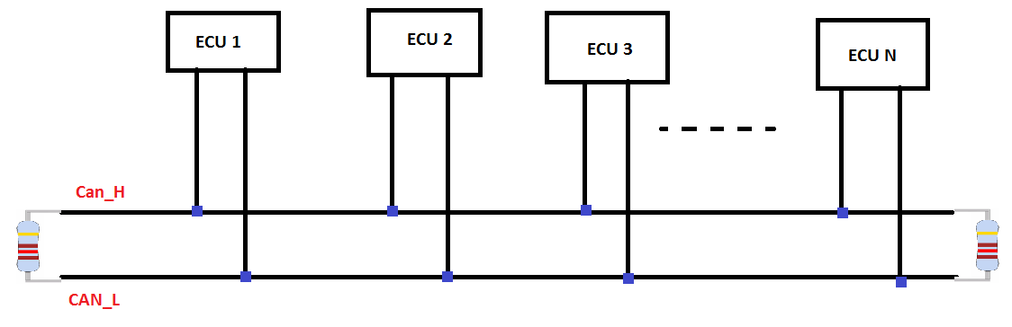
CAN Network Topology

